Slide 1
Week03 Solution
Stacey Wang

Slide 2
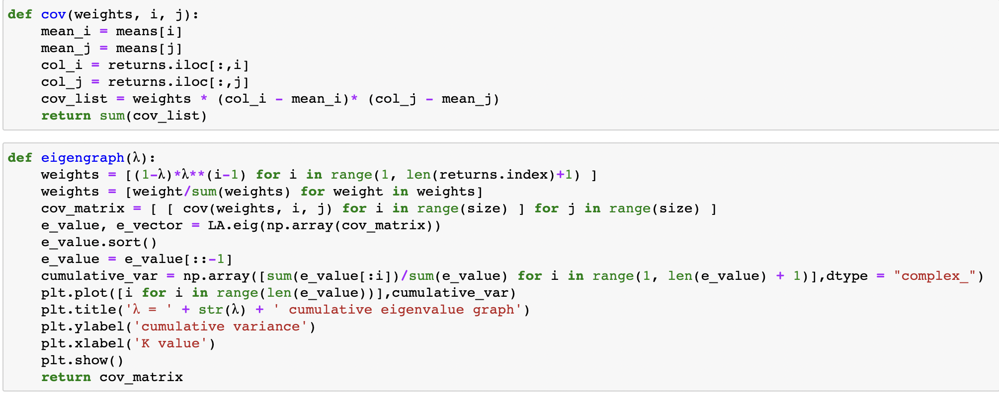
Problem 1- PCA code & implementation

Slide 3
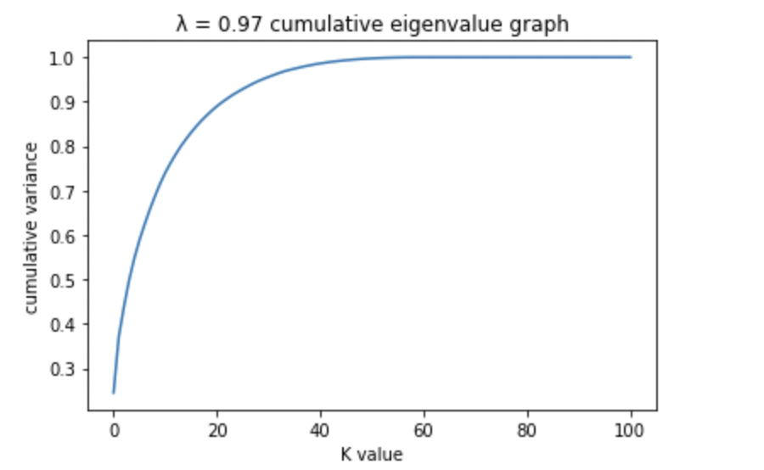
Problem 1 - Lambda = 0.97

Slide 4
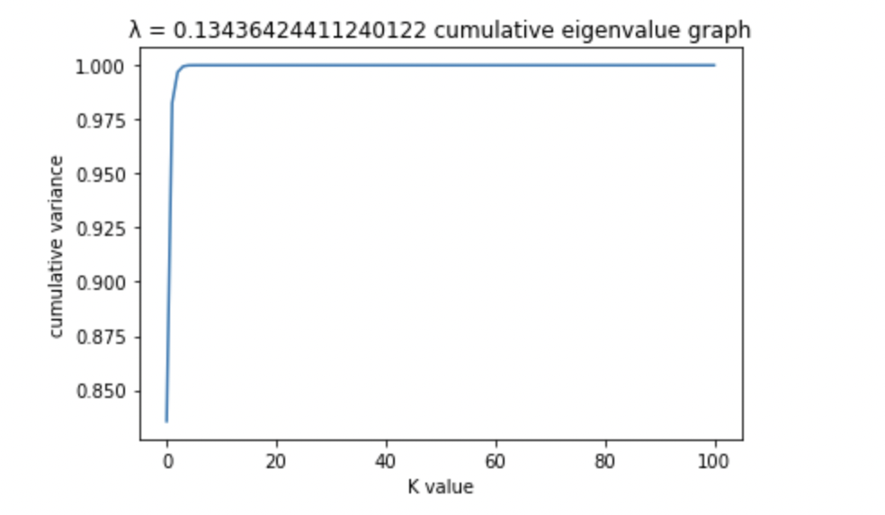
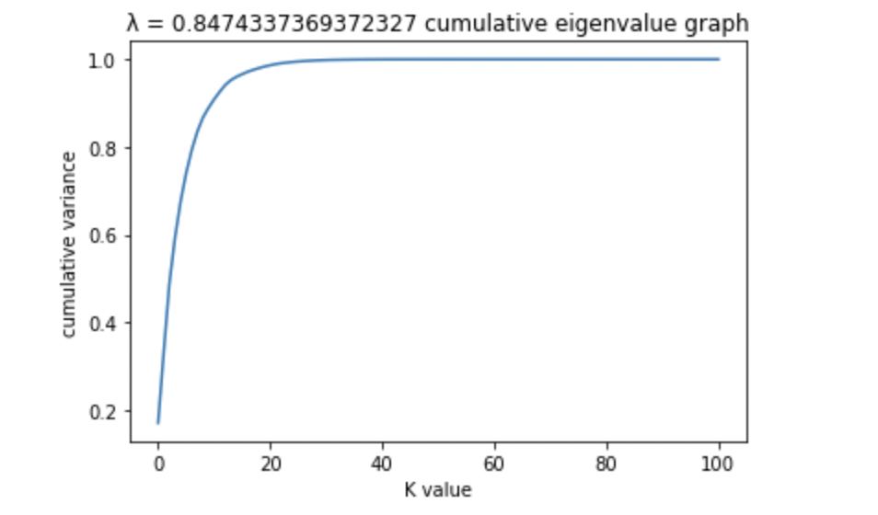
Problem 1- Lambda in range (0, 1)
Observation:
As lambda get bigger, the initial slope gets less and less steep and edgy

Slide 5
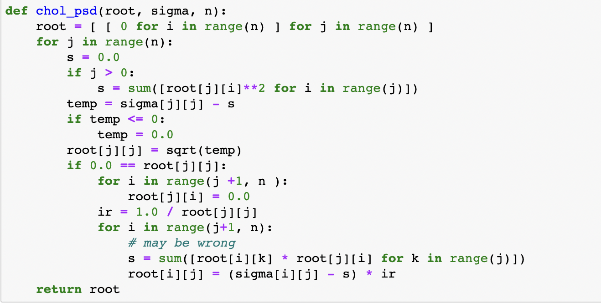
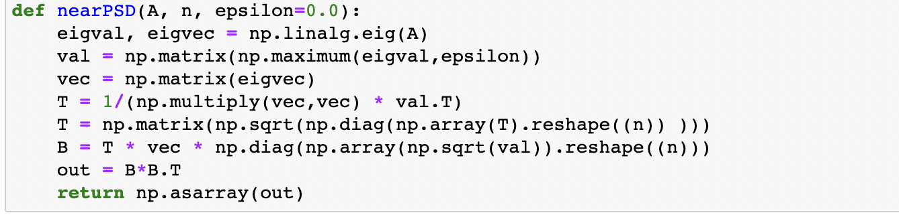
Problem 2
chol psd()
near psd()

Slide 6
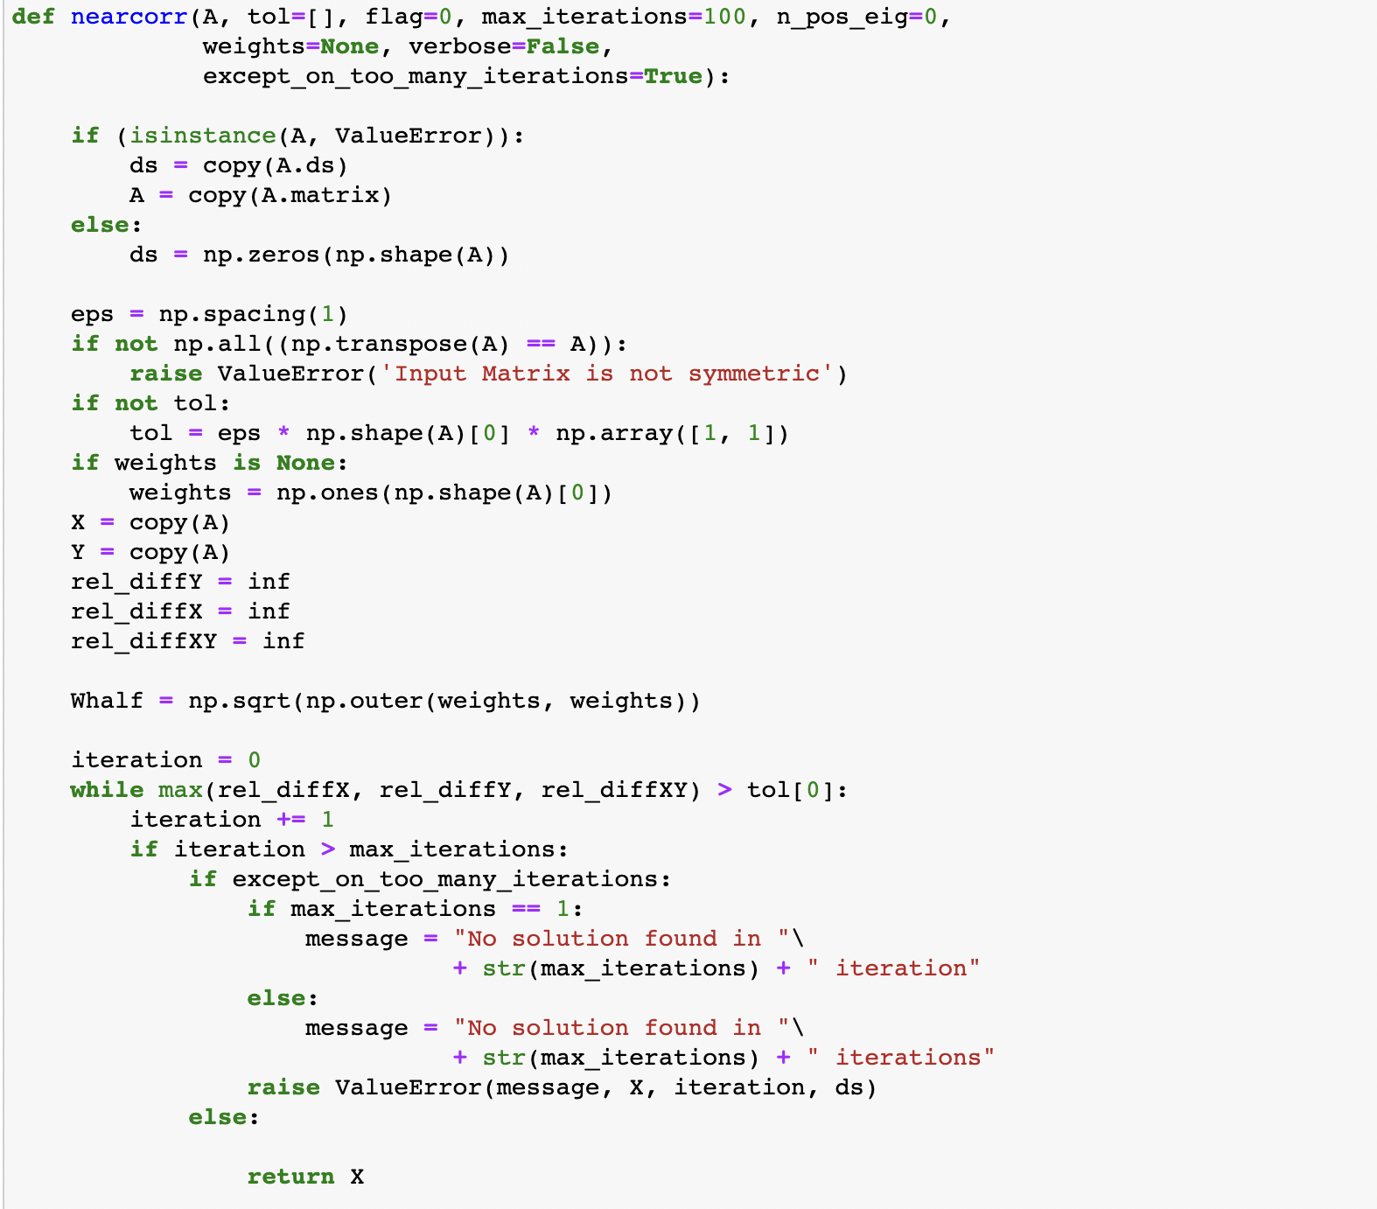
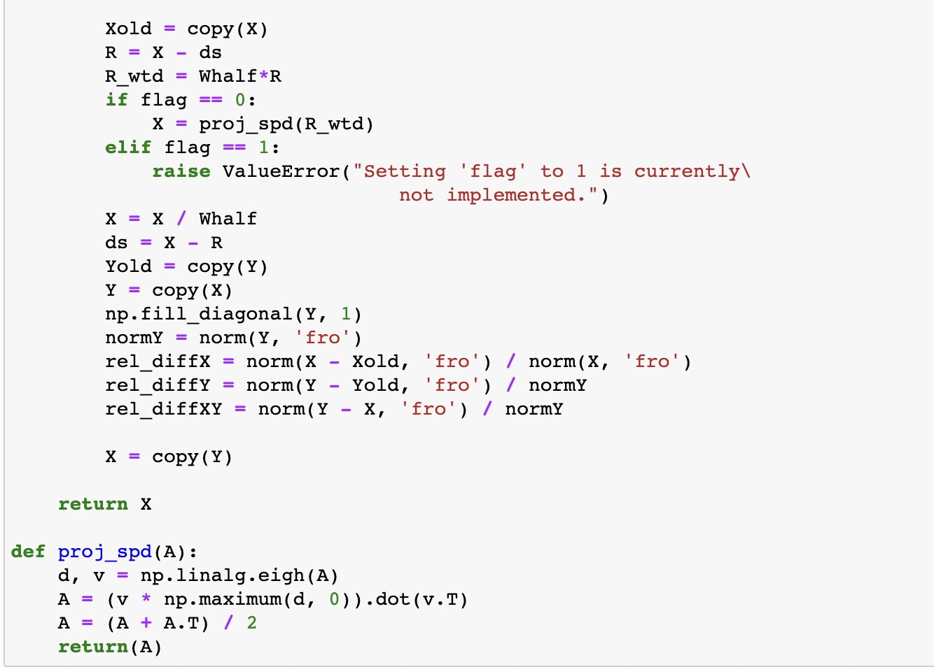
Problem 2 - Higham

Slide 7
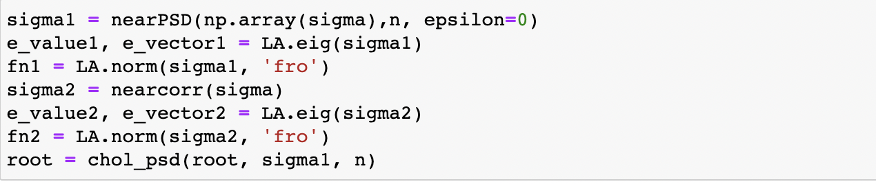
Problem 2
Generate a non-psd matrix:

Slide 8
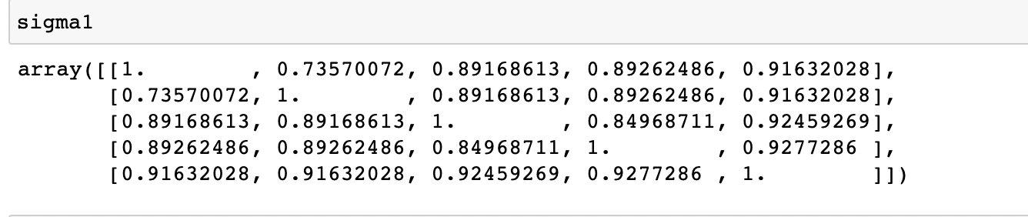
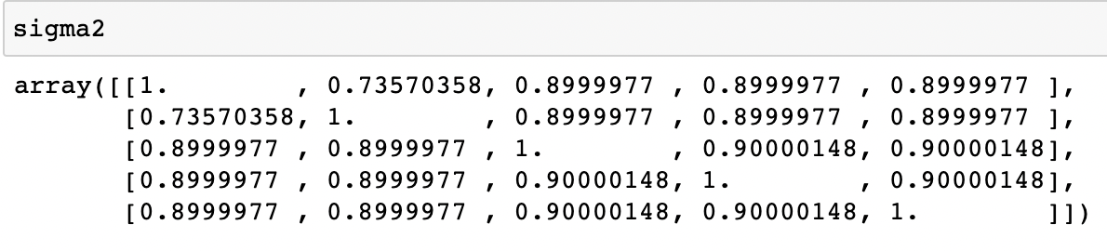
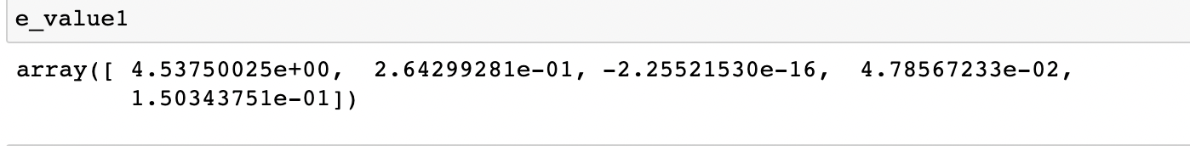
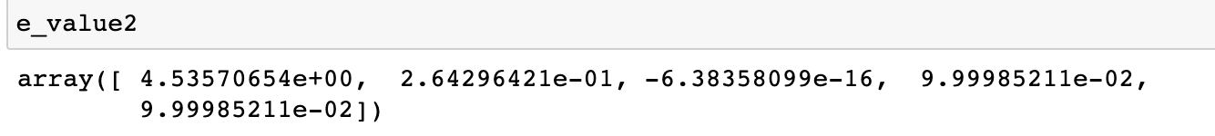


Problem 2
Use near psd():
Use Higham：
Frobenius Norm 1
Frobenius Norm 2

Slide 9
Problem 2
The eigenvalues of both Higram and near psd method are greater or equal to zero (minor floating error can be ignored)
=>therefore proven that both functions work
=>both matrix are psd

Slide 10


Problem 2
For a 5 x 5 matrix:
For a 500 x 500 matrix:
Even for 5*5 matrix, the run-time for Higham is longer than near psd; for a 500*500 matrix, the run-time for Higham is significantly longer than near psd method
=> As n increases, the Higham function takes up significantly more amount of time to run

Slide 11
Problem 2 - Conclusion
The Higham method takes up more time to run and provides more precision about the output compared to the near psd method. The conclusion is more significant as N increases.
The decision between whether to use the Higham method or the near psd is a tradeoff between time consumption and precision. When in a situation where an output is needed in a short time, the near psd method should be used and some precision may be sacrificed; when in a situation where no one is in a rush of getting the output, the Higham can be implemented. It also depends on how big N is, the larger the N gets, the longer it takes for Higham to run, and the larger the gap between the run-time of Higham and the near psd.

Slide 12
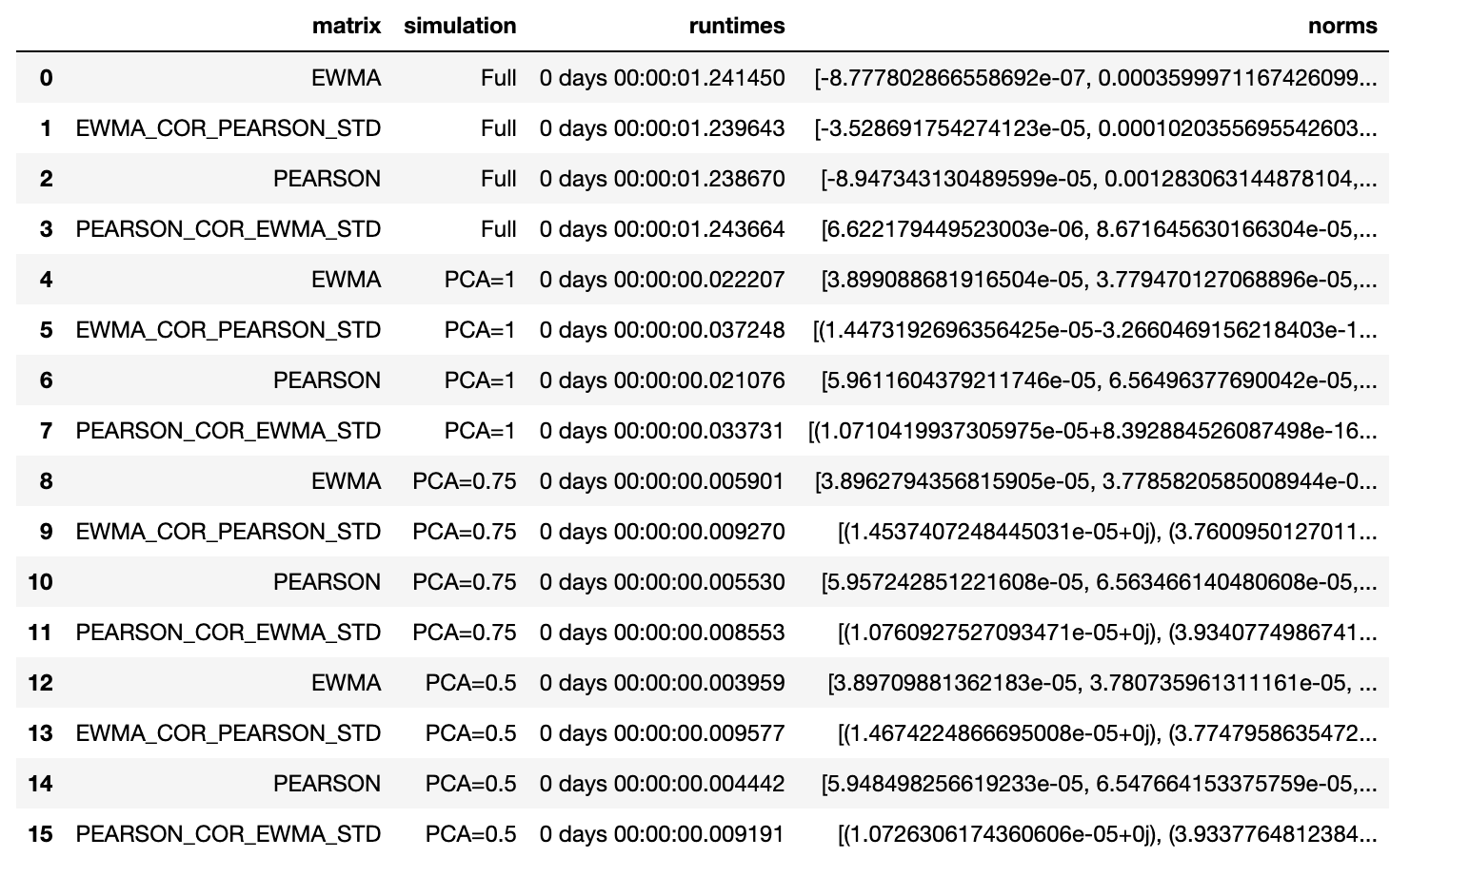
Problem 3

Slide 13
Problem 3 - Conclusion
The EWMA_COR_PEARSON_STD and PEARSON_COR_EWMA_STD consumes the more time, especially when percentage k explained gets smaller

Slide 14
Thank You

